Slide 1
MIS 321
Command Pattern

Slide 2
The Problem – Smart Home App
We want to create a Smart Home App
The app should allow you to add devices to be controlled from the app
For each device you should be able to toggle it on and off.
i.e. turn the kitchen lights on or the fireplace off
There should be a global “undo” button that undoes the last command

Slide 3
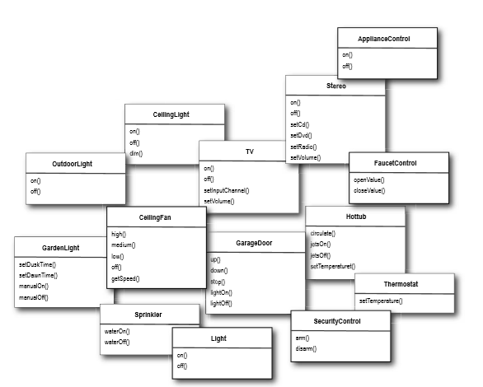
The Problem
While each vendor provides an interface to turn their device on and off, there could be LOTS of devices.

Slide 4
Command Design Pattern
An object is used to represent and encapsulate all the information needed to call a method at a later time.
This includes the method name, the object that owns the method and values for the method parameters.
Is a behavioral pattern

Slide 5
Command Pattern – Put another way…..
Allows you to store lists of code that is executed at a later time or many times.
The client says “I want a command to run when execute() is called on one of these encapsulated objects”
An object called the invoker transfer this command to another object called a receiver to execute the right code
In our example, this could be : TurnTVOn – AppButton – TurnTVOn – Television.TurnTVOn()

Slide 6
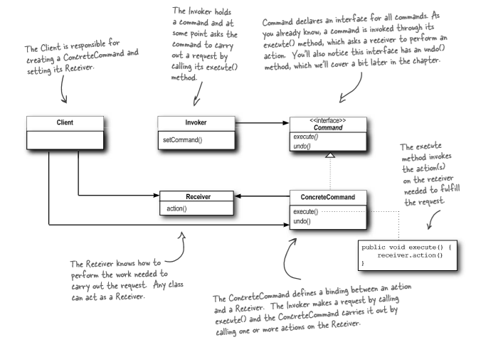
Command Pattern

Slide 7
Benefits
Allows you to set aside a list of commands for later use
Provides a place to store procedures you want to be executed
Can store multiple commands in a class to use over and over
Can implement undo procedures

Slide 8
Drawbacks
Lots of small classes that store lists of commands

Slide 9
Let’s try it
Create interface for an Electronic Device
Called IElectronicDevice
Has two void methods called On() and Off()
Create 2 electronic device class (lights & TV)
Implements IElectronicDevice
Add a Location Property
WriteLine the state of the device (i.e. Location + lights are on)

Slide 10
Let’s try it
Create interface for the command
Called ICommand
Has one void method called Execute()
Create TurnTvOn class
Implements ICommand
Create Electronic Device property and set it in the constructor
In execute method call the on() method for the device property
Replicate this class for TurnTvOff, TurnLightOn, and TurnLightOff

Slide 11
Let’s try it
Create the Invoker Class
Call it AppButton
It should have a ICommand property which should be set in the constructor
Create a method called Press
Void method that calls the execute method on the passed in ICommand

Slide 12
Let’s Test!
Create an ElectronicDevice for a TV
Create new TurnTVOn command passing in the TV Device
Create an AppButton called onPressed passing in the command created in the previous step
Call onPressed.press()

Slide 13
Let’s Test!
Create new TurnTVOff command passing in the TV Device
Update onPressed setting it equal to a new DeviceButton passing in the command created in the previous step
Call onPressed.press()

